Slide 1
Section 6

Slide 2
Admin
Office Hours: Wednesday 1-2PM!
Homework 2: Tuesday!
Course and Section Feedback?

Slide 3
Agenda
Stochastic Gradient Descent (~10 min)
Question 1
SVMs (~15 min)
Question 2
PyTorch (~20 min)
Notebook

Slide 4
Stochastic Gradient Descent

Slide 5
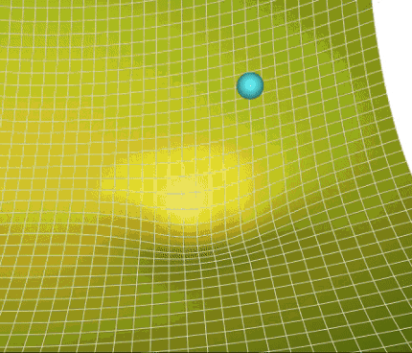
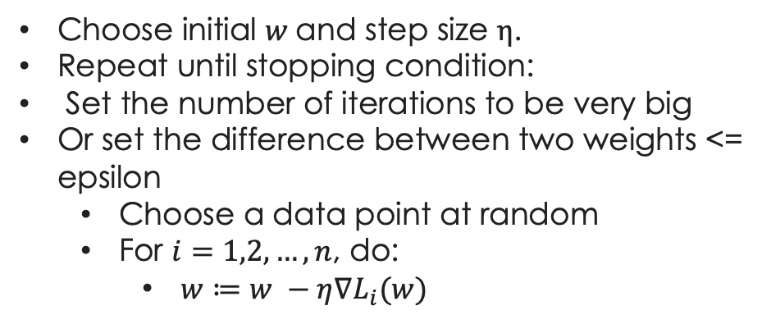
SGD – Algorithm
Choose initial $w$and step size $η$.
Repeat until stopping condition:
Set the number of iterations to be very big
Or set the difference between two weights <= epsilon
Choose a data point at random
For $i=1,2,…,n$, do:
$w≔w −η∇L_{i}(w)$
A Visual Explanation of Gradient Descent Methods (Momentum, AdaGrad, RMSProp, Adam) | by Lili Jiang | Towards Data Science
Look familiar?

Slide 6
X_1, x_2, … x_10 for (1000) iterations: L = loss of x_i (whereas in GD we calculate the loss of all x_i) calculate gradient dL/dw

Slide 7



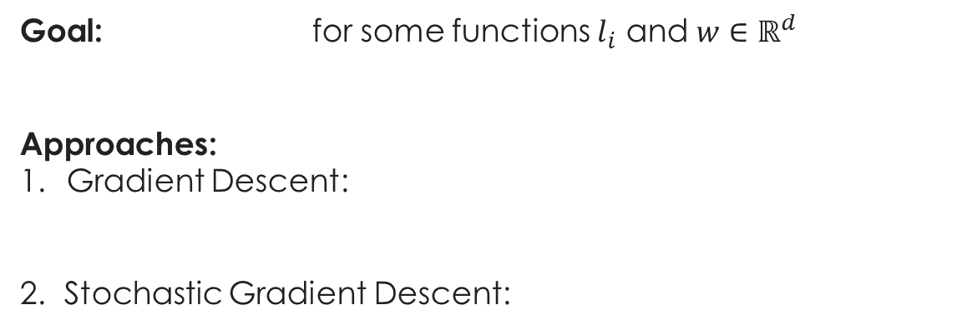

SGD – Motivation (1)
Goal: for some functions $l_{i}$ and $w∈ℝ^{d}$
Approaches:
Gradient Descent:
2. Stochastic Gradient Descent:
for $I_{t}$ drawn from $\{1,..,n\}$

Slide 8
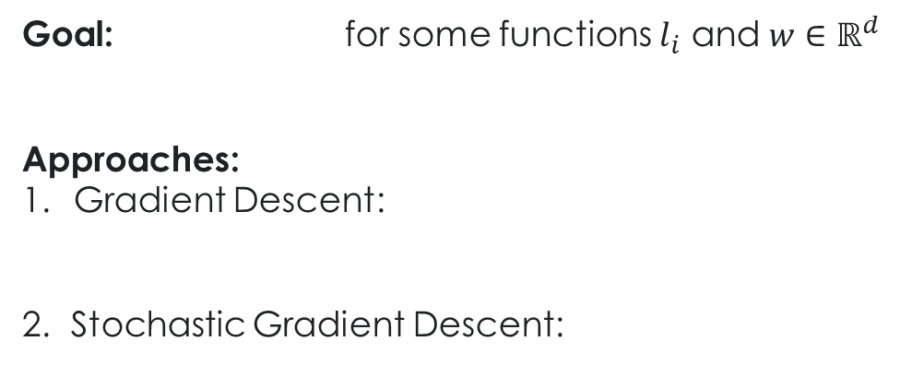
SGD – Motivation (1)
Goal: for some functions $l_{i}$ and $w∈ℝ^{d}$
Approaches:
Gradient Descent:
2. Stochastic Gradient Descent:
One step?

Slide 9
SGD – Motivation (1)
Goal: for some functions $l_{i}$ and $w∈ℝ^{d}$
Approaches:
Gradient Descent:
2. Stochastic Gradient Descent:
One step:

Slide 10
SGD – Motivation (1)
Goal: for some functions $l_{i}$ and $w∈ℝ^{d}$
Approaches:
Gradient Descent:
2. Stochastic Gradient Descent:
One step:
Note: The proof for SGD assumes that we sample a data point with replacement. However, in practice, people sample data points without replacement, as it’s been proved that this leads to faster convergence.

Slide 11
SGD – Why it works! (1a)
SGD
GD

Slide 12







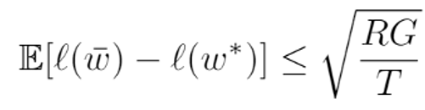
SGD – Why it works! (1b)
Define: Let:
Notes:
Below is
Result:

Slide 13
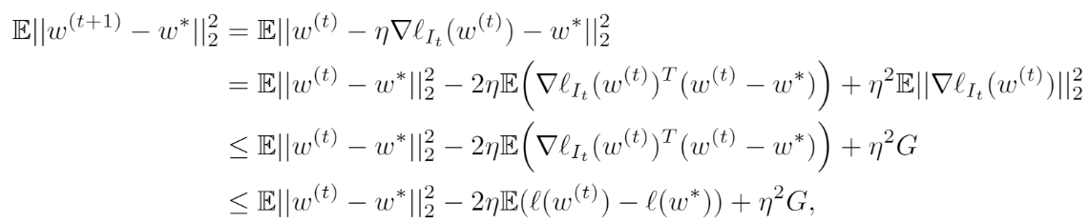
SGD – Why it works! (1b)
Result:
Proof (details in solution):

Slide 14
SGD – Disadvantages (1b)
Because we choose only 1 data point to update the weights, Var(X bar) = 1/n Var(Xi) the variance will be very big if we just use a single data point each time to update the weights. Noisy training examples make the gradients offshoot to a different direction. For linear / logistic regression, noisy examples might not be much of a big deal as the objective function is convex, but for neural networks where there are a lot of local minima, noisy examples can cause the gradients to lose direction and the direction of good direction is not recoverable.

Slide 15

SGD – Disadvantages (1b)
Noise induced Gradient Descent:
Solution: Mini-batching!

Slide 16
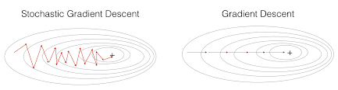
SGD – Disadvantages (1b)
Optimization methods (datascience-enthusiast.com)

Slide 17
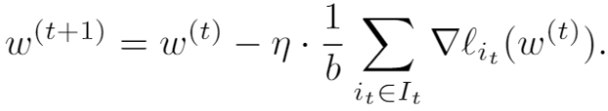


SGD – Minibatching (1c)
where
Properties:
1. Unbiased:
2. Compared to SGD, much lower variance
3. Higher computational cost:
Mini-batch is a happy medium between a large variance (SGD) and large computational cost (GD). We choose a batch size
big enough to calculate the gradient. In practice, people often use batch size of power of 2 such as 16, 32, 64, 128.

Slide 18
SGD – Minibatching (1d)

Slide 19
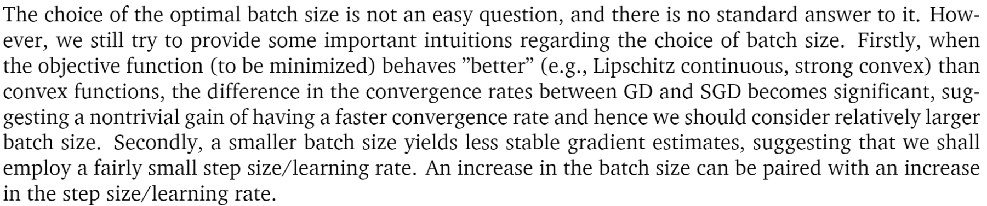
SGD – Minibatching (1d)

Slide 20
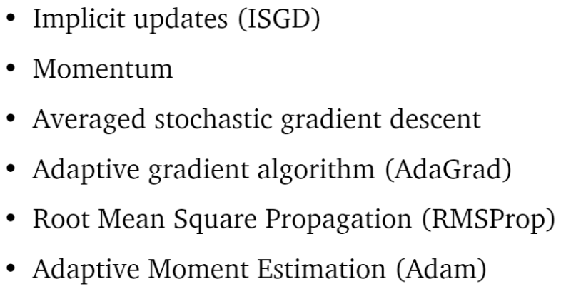
SGD – Improvements

Slide 21
Support Vector Machines

Slide 22

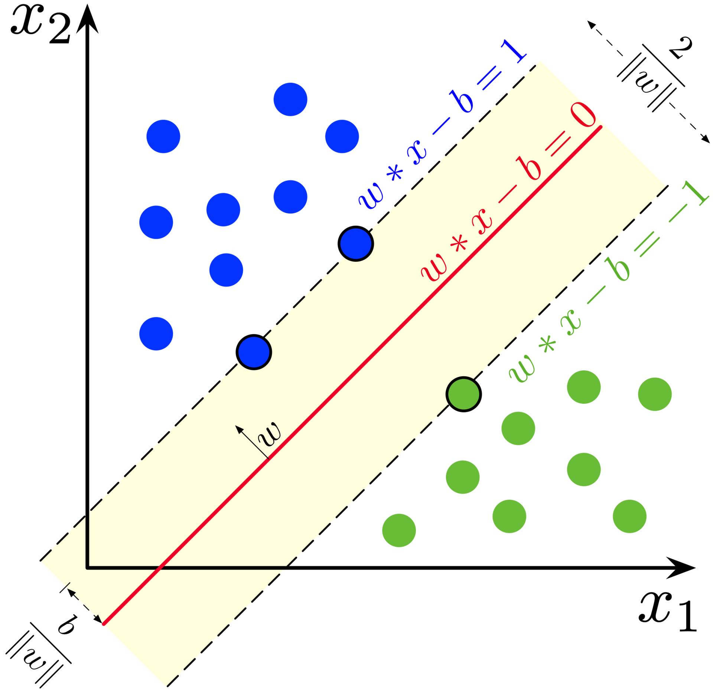
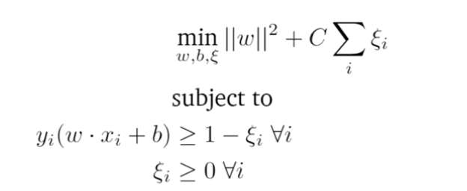
SVMs
Find optimal hyperplane between classes in data
What does vvvvvvvv represent?

Slide 23
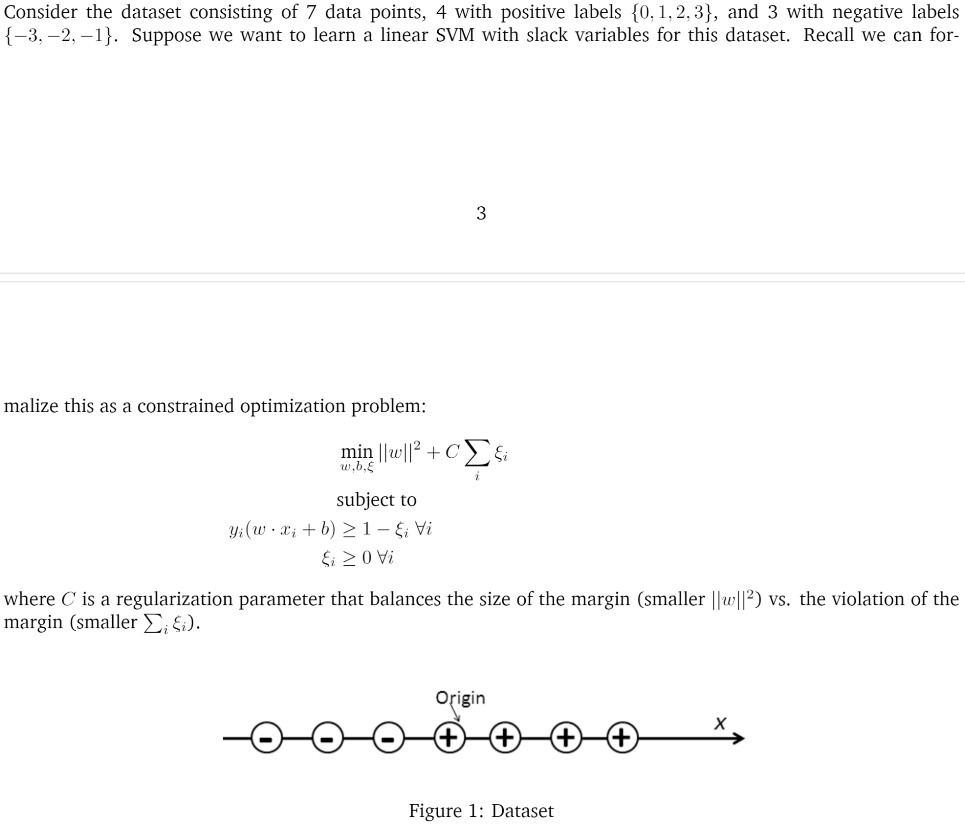
SVMs – 1D Setup

Slide 24
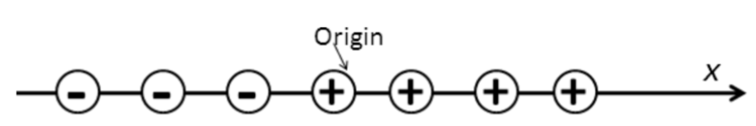
SVMs – 1D (1a)

Slide 25
SVMs – 1D (1a)
Or 0

Slide 26
SVMs – 1D (1b)

Slide 27
SVMs – 1D (1b)

Slide 28
PyTorch

